Slide 1
Manukau Institute of Technology

Slide 2
What ICTS Means to you ?
What’s the function of ICTS in MIT?
What they do?
How they operate?
What’s the aim or direction of ICTS?
Do you see any changes or improvements?
How is your experience?

Slide 3
MIT ICTS Structure
Michelle Teirney
CFO & Director Corporate Service
Carmen Lopez
EA to CFO & Director Corporate Services
John Holley
Head of ICTS
Steve Jones
Service Delivery Manager
Melanie Visser
Business Analyst
Russell Smith
Systems Manager
Nick Brooker
Senior Infrastructure Engineer
Stephan Hughson
Senior Systems Engineer
Justine Silbery Infrastructure Engineer
Chris Farrell Communication Systems Technician
Paulo Quizora Infrastructure Engineer
Klim Belchev
Systems Engineer
Alex Degtyrev Systems Engineer
Suranga De Silva Systems Engineer
Eason Liu
Systems Engineer
Ioana Nicolau
DBA & BI Specialist
Sam Wong
Systems Administrator
Peter Chen
Systems Engineer
Rodger Hanson
Systems Engineer
Orlando Cisneros System Engineer
Bart Kreesta
Service Delivery Specialist
Marian Sosna
Service Delivery Specialist
Semi Leo
Service Delivery Specialist
Tony Lowen
Service Delivery Specialist
Ewan Tan
Service Delivery Specialist
Priyank Lao
Senior Help Desk Technican
Manette De Beer Help Desk Technician
Shynel Prasad
Help Desk Technician
Kazi Rahman
Senior Service Delivery Specialist
San Ly
Help Desk Technician
Jonas Freue
Service Delivery Specialist
Nadine Thompson ICTS Administrator
Krishan Mani
eMIT Support Specialist

Slide 4
ICTS Team
Head of ICTS
Service Delivery Team/ Operations (1 manager)
Service Desk (4) Information & Help
Service Delivery (7+ 2C) Maintenance
Emit Specialist – 1 System Admin
Systems Team (1 manager)
Infrastructure Engineers -3 Network
Communications Systems Technician -1 Telephones
System Engineers -6 Servers
DBA Specialist -2 Databases
Systems Administrator -1 Server Admin
Business Analyst -1 Processes
ICTS Administrator -1 Purchasing

Slide 5
MIT Infrastructure Summary
ICTS caters for about
18,000 users,
4,000 desktops,
1200 laptops,
220 iPads,
150 MDF’s,
650 APs,
350 AV systems,
400 applications,
750+ Thin Clients,
1,000 support tickets per month
- 2,000+ BYOD
ICTS supports 2 main campuses and 9 sites across Auckland & North Island
Notes:
SLA met is avg 87%

Slide 6
Service Delivery Team Scope
2nd level service and support which includes all offered services
Student and staff computing devices
AV and Wi-Fi
BYOD
Regardless of OS type
HW installations and provisioning
Maintain assets and records
Operational process follow
Compliance and customer focused
UAT for new or improved systems, apps or infrastructure
Coordinate and support Service Desk and Systems Team
Deployment OS and apps as required
Projects & Initiatives
Any other tasks assigned by Management

Slide 7
ICTS Operation Working Strategy
Digital & BYOD Strategy
Notes:
The four components of the Digital Strategy are represented in the blue band in the diagram
below. The key outcome/benefit associated with each component is contained in the green
band and the near term significant action is shown in the grey band. Execution details are
available in a supplementary set of papers (some of the detail has been previously shared
with the Leadership Team).

Slide 8
ICTS Priorities & Plan
Futures Programme: LMS
BYOD
Cloud Computing
MIT BI/Analytics Pilot
Updated ICTS Business Continuity Plan/DR plans
Hardware Renew
MIT Wide Citrix (thin client) deployment
MIT Skype for Business/ Unified Comms
Upgrade the Core Network
Notes:
The direction comes from Top Mgmt and MIT Strategy: Network 2M for network reliance and performance improvement

Slide 9
ICT Delivery Framework
Purely follow ITIL Framework for Service Delivery and ITSM
ISO 27001 for ICT policy and guideline
PPM (project and portfolio management)- Planview
Change control/ CAB with ITIL framework

Slide 10
Basics of ITIL
ITIL is the most widely adopted framework for IT Service Management in the world. It is a practical, no-nonsense approach to the identification, planning, delivery and support of IT services to the business.
In 80’s UK Government Commerce recognized that utilizing consistent practices for all aspects of a service lifecycle could assist in driving organizational effectiveness and efficiency as well as predictable service levels
Service Strategy – understanding who the IT customers are and needs
Service Design – new and change service design to meet requirements
Service Transition – Design is built to test and production
Service Operation – BAU and health check of offered services
Continual Service Improvement – offer to measure and improve service level of efficiency/ effectiveness
Notes:
ITIL is typically used in conjunction with one or more other
good practices to manage information technology such as:
COBIT (a framework for IT G • overnance and Controls)
• Six Sigma ( a quality methodology)
• TOGAF (a framework for IT architecture)
• ISO 27000 (a standard for IT security)

Slide 11
Service Operation Functions
IT Operations Management
IT Operations
Control
Console Management
Job Scheduling
Backup & Restore
Print & Output
Technical Management
Application Management
Mainframe
Financial Apps
Server
HR Apps
Network
Business Apps
Storage
Facilities
Management
Data Centers
Recovery Sites
Consolidation
Contracts
Databases
Directory
Service Desk
Desktop
Middleware
Internet / Web
© Copyright 2011. Reproduced under license from the Cabinet Office Based on Figure 6.1 Service Operation 6.2.1

Slide 12
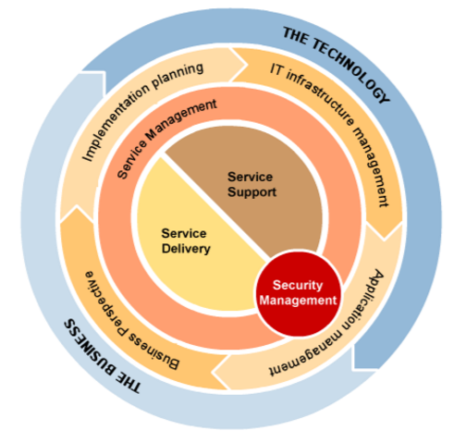
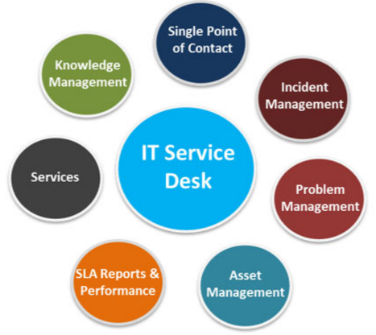
Service Desk and Service Delivery

Slide 13
ICTS- Service Desk (Help Desk)
We provide single point of contact
We provide staff and students with information, support, related to MIT’s Information and Communication Technology services as per SLA
We can be contacted on
Phone: Ext. 7600, option 2
Email address: icts.helpdesk@manukau.ac.nz
http://Service.manuaku.ac.nz
http://icts.manukau.ac.nz/
On Site Support (Otara & MITM):
Mon – Thurs (7:30 am – 6:00 pm)
Friday 7:30 am – 4:00 pm
Term break Mon – Fri 7:30 am – 4:00 pm

Slide 14
Key Periods & Timing
Semester Start/ END and break
Long weekends
Xmas time
Renovation and relocation/ project
Any construction or site provisioning
24X7 support
Notes:
Summer school is really an extra pressure for us

Slide 15
SLA & KPIs – Performance Indicators
95% SLA
95% HEAT jobs
100% Organization deadlines
Response within 48hrs
Actions:
Report monthly
Response immediately for any security incident or classroom outage
Communicate major planned or unplanned outage
Project Delivery on time with allocated scope & resources
Always compliance on EHS areas
Improved Customer Service

Slide 16
What is important for ICTS
Promised SLA
Availability
Security
Customer service
Skills or knowledge
Talent retention

Slide 17
Technical Skills Management
Training following 70/30 rule
Team Knowledge Transfer Sessions
Cross-skilling
Shadowing and job rotation
Internal workshop
Internship/ job experience
Friday open session
FGD/ Focused Group Discussion
Notes:
100% of ICTS staff are ITIL v3 certified.

Slide 18
Professional Skills Management
IITP Membership
Microsoft & Cisco Certifications
IITP CTech and other certification/ courses
Strength Coaching
On the job training
Mentoring and support program
Career development and support
Notes:
Flexible working hrs, sometimes working from home etc

Slide 19
Measure KPIs/ Performance
Perform & Development Plan
System based reporting
Availability
Security incidents
SLA
Breached report & actions
Accomplished projects
Process & compliance; CAB, NZ audit
Customer satisfaction index
Living with MIT values
Random feedback

Slide 20
ICTS Working Streams
Business As Usual (BAU)
People & Culture
Project
HOIT/ Directors
Surprises

Slide 21
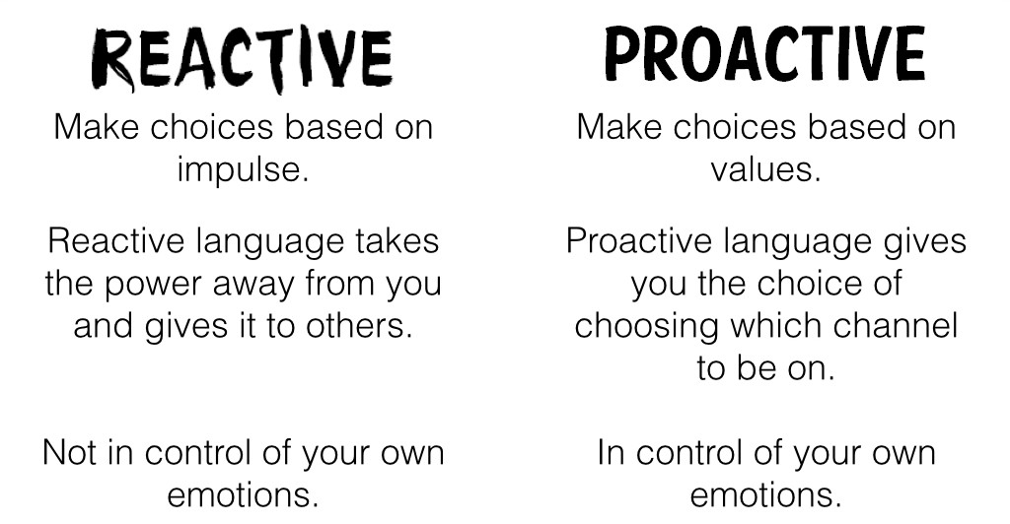
ICTS Response Approach
Proactive/ Reactive
Detection/ Prevention

Slide 22

Limitations
Resource constrain
Time
People
Fund
Shifting priorities
Change goals & directions
Lack of visibility
Clear communication
Shared or cross-skilling
Resistance for change

Slide 23
Service Delivery Management Typical Day…
Day starts with turning ON lights
Checking physical security of ICTS building
Check for any update regarding system outage and faults
Morning team meeting
Monday & Wednesday for 30mins
Issues, resources & redefine priorities for the week
Open HEAT email/ Jobs
Prioritise URGENT/ IMPORTANT jobs
Log jobs and review every now and then
Follow-up with users

Slide 24
SDM Typical Day cont..
Deliver promised services
Plan for meetings, conference calls
Allocate jobs among team
Sometimes top priority from SDM/ HOIT emails
Follow-up about delivery timelines
Reporting of jobs and update tickets
Everyday is not the same and journey never stops..

Slide 25
Summary
Always high expectation
Focus on customer service
Compliance
Security
Future proof solution
Continual Service Improvement (CSI)
Evolve the whole journey….

